Slide 1
MALIGNANT COMMENT CLASSIFIER

Slide 2
CONTENTS
Problem Statement
Exploratory Data Analysis
Visualization
Data Cleaning
Model Testing

Slide 3
PROBLEM STATEMENT
The proliferation of social media enables people to express their opinions widely online. However, at the same time, this has resulted in the emergence of conflict and hate, making online environments uninviting for users. Although researchers have found that hate is a problem across multiple platforms, there is a lack of models for online hate detection.
Online hate, described as abusive language, aggression, cyberbullying, hatefulness and many others has been identified as a major threat on online social media platforms. Social media platforms are the most prominent grounds for such toxic behaviour.
There has been a remarkable increase in the cases of cyberbullying and trolls on various social media platforms. Many celebrities and influences are facing backlashes from people and have to come across hateful and offensive comments. This can take a toll on anyone and affect them mentally leading to depression, mental illness, self-hatred and suicidal thoughts.
Internet comments are bastions of hatred and vitriol. While online anonymity has provided a new outlet for aggression and hate speech, machine learning can be used to fight it. The problem we sought to solve was the tagging of internet comments that are aggressive towards other users. This means that insults to third parties such as celebrities will be tagged as unoffensive, but “u are an idiot” is clearly offensive.

Slide 4
EXPLORATORY DATA ANALYSIS
In malignant comment classifier project, we have to find which comments are highly abusive and hatred.
This project contains two datasets; Training dataset and testing dataset. Training dataset contains 159571 rows and 8 columns. Test dataset contains 153164 rows and 2 columns. Training dataset contains columns which include different comments columns; Malignant, Highly Malignant, Rude, Threat, Abuse and Loathe.
These different columns of comment has labels 0 and 1. Where 0 denotes NO and 1 denotes YES. To find the highly malignant comment we have to first import some important libraries. After importing the libraries we have to read and load the dataset. After loading the dataset first we have to analyzed the data. After analyzing the data we have to work on dataset for finding the null values, duplicated values etc.
If one of the column is not important for our model, we can dropped that column.

Slide 5
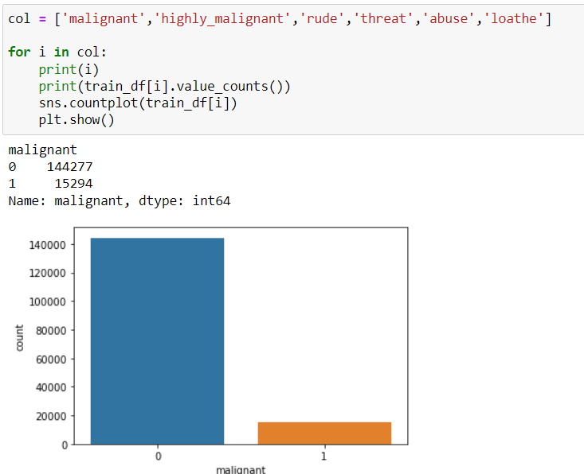
VISUALIZATION
Plot shows the value counts in malignant column.
Plot tells that, number of non malignant comment is higher than the malignant comment.
0 indicates NO and 1 indicates YES.

Slide 6
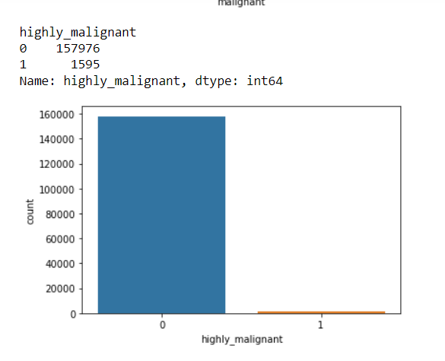
Given plot shows the value counts in highly malignant comments.
The number of non highly malignant comment is much more than the highly malignant comment.

Slide 7
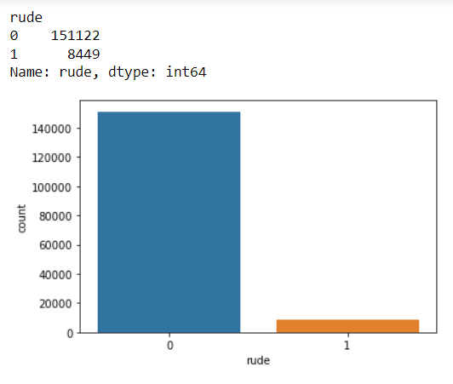
We can see that, the value counts of rude column.
From the plot we can see that the number of non rude comments is greater than the rude comments.

Slide 8
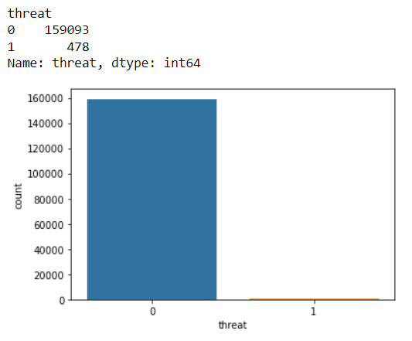
Count plot shows the value counts in threat column.
There is only a few comments which are threatening other are non threatening comment.

Slide 9
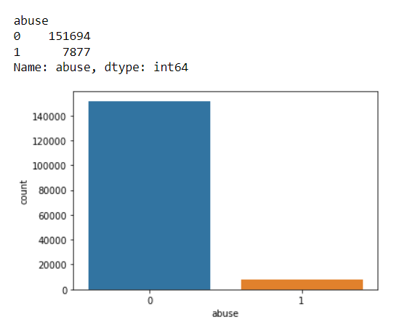
Now we see a value counts in abuse column.
Number of non abuse comment are maximum than the abuse column.

Slide 10
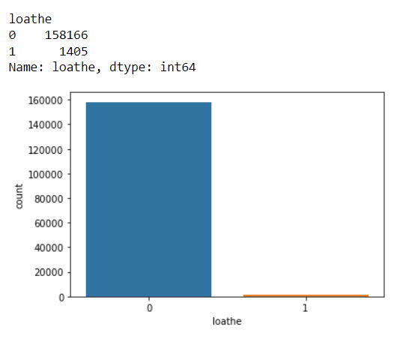
Plot shows the value counts in loathe column.
Here is also number of non loathe comment is more than the loathe column.

Slide 11
DATA CLEANING
SKEWNESS
Skewness is an asymmetric curve in set of data.
Skewness can be right or positive skewness.
It can be left or negative skewness.
It can be zero or normal skewness.
DATA CONVERSION
Data conversion is an important step in machine learning program.
Objective data is converted into numerical data in Data Conversion.
By using Label Encoder we convert the data.
OUTLIERS
An outlier is something which is different from given data.
Distance of an outliers from the other points is out of range.

Slide 12
Splitting the Data
Data is splitted into two parts; dependent data and independent data.
In splitting process target or dependent column should be drop.
In this program we splitted the data into x and y.
X is an independent variables and y is the dependent variable.
Cross Validation Score
Cross validation is an important concept in machine learning.
It can reduces the size of data.
MODEL TESTING
Testing the model is an important process in machine learning.
Malignant comment classifier project is classifier project.
We used Logistic Regression for this project.

